Slide 1
WATER DISINFECTION
VAN ALSTYNE
CONVERSION FROM CHLORINE TO CHLORAMINES
WATER SYSTEM DISINFECTANT
august 14-17, 2023

Slide 2
VAN ALSTYNE WATER SUPPLY
Van Alstyne Water Wells
  4 Active Wells – 1,3,4,5 – (See Map)
Collin Grayson Municipal Alliance (CGMA) Pipeline
  Surface water from the north texas municipal water district (NTMWD)
  Connection located at site of well 6 (well is inactive) – (See Map)
Growth in Van Alstyne requires additional supply from the CGMA water main

Slide 3
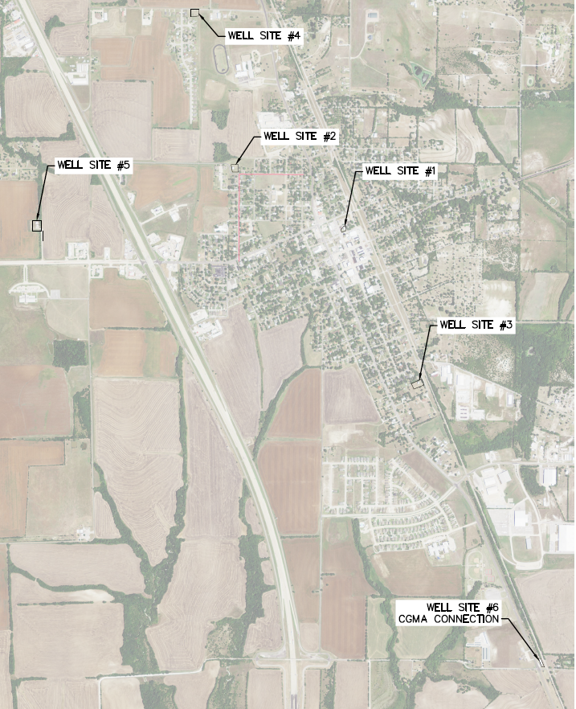
Map of
Van Alstyne
Well Sites

Slide 4
NEED FOR DISINFECTION
Well Water historically has no harmful substances & has been a drinking water supply without treatment for many centuries
  Disinfection required for distribution systems
Surface Water typically contains small amounts of harmful pathogens and bacteria
  Cryptosporidium
  Giardia
  E-Coli
  Legionella

Slide 5
WHAT IS DISINFECTION
Disinfection includes 2 Parts
  Primary Disinfection - Initial removal of harmful bacteria & pathogens contained in water after removing water from source
  Secondary Disinfection - Maintaining safety of water throughout the distribution system – water is pumped into pipes that deliver to customers

Slide 6
TYPES/METHODS OF DISINFECTION
Ozone Disinfection
  Effective disinfection for primary treatment of surface water
  Used by NTMWD for primary disinfection
Physical removal – filter bacteria and pathogens
  Ultrafiltration Membranes
  Microfiltration filters

Slide 7
TYPES/METHODS OF DISINFECTION
Chlorine
  Very effective on all harmful bacteria
  Works very quickly
  Dissipates over time
Chloramines
  Effective on all harmful bacteria
  Has a longer residual life than Chlorine
  Used to maintain disinfection residual by NTMWD

Slide 8
HISTORY OF DISINFECTION
Chlorine first used in 1908 in New Jersey
  Common throughout US in 1930s
  Surface water sources became more prevalent
Chloramine first popular in 1930s
  Became more popular beginning in 1970s as systems became larger & analysis techniques improved to identify previously unknown constituents including Disinfection Byproducts
  Approximately 45% of US Population served by public water supplies using Chloramine – approximately 30% of systems

Slide 9
CURRENT DISINFECTION IN VAN ALSTYNE
Van Alstyne Wells
  Chlorine – Primary & Secondary Disinfection – All Wells
CGMA Water Service (from NTMWD)
  Ozone as Primary Disinfection at Water Treatment Plant
  Chloramine as Secondary Disinfection for Maintaining Residual – arrives in Van Alstyne
  Van Alstyne currently uses Chlorine to convert Chloramine to Free Chlorine prior to pumping to match VA sources

Slide 10
WATER QUALITY ISSUES IN VAN ALSTYNE
Van Alstyne customers – current concerns about water quality
  Taste & Odor of water
  Discoloration of water from tap
  Many complaints also occur when NTMWD changes to chlorine residual for a short period each year
Virtually ALL water quality issues have occurred in the Georgetown & Mantua developments
Efforts to address concerns include conversion to chloramine disinfection for consistency in water supply

Slide 11
Benefits vs. concerns – chloramine conversion
Benefits
  Conversion will make all water in Van Alstyne system have the same chemistry as water from CGMA – changing CGMA water to chlorine disinfection is possible source of quality issues
  Disinfectant residual lasts longer in the system
  Reduced production of disinfection byproducts that are identified carcinogens
  People generally believe chloramine water has a better taste than chlorine
Concerns Related to Chloramine Conversion
  Chloramine is a weaker disinfectant than Chlorine
  Presence of excess ammonia can cause Nitrification in pipelines
    Can result in taste and odor issues
    Can result in release of organic material if free ammonia exists in water
    People & facilities that perform dialysis cannot utilize chloraminated water – reason for notification prior to implementing the change

Slide 12
Process to convert to chloramines
TCEQ requires notice to all customers
  Written notification to each customer – exact wording required – minimum 14 days prior to change
ADDITIONAL NOTIFICATION – LETTER EMAIL OR HAND DELIVERY
NEW CUSTOMERS ALSO MUST BE NOTIFIED BEFORE RECEIVING WATER

Slide 13
ADDITIONAL REQUIREMENTS
Van Alstyne must develop a nitrification action plan – draft plan has been developed
Additional testing of water required during initial time period of implementation
  NOTE: VA staff will be performing extensive testing during implementation of conversion to chloramines
Ongoing sampling required as part of nitrification action plan
Prepare notice for all new customers – those opening new accounts

Slide 14
CONVERSION TO CHLORAMINE DISINFECTION
Van Alstyne Well Sites
  New facilities constructed to disinfect with chorine and ammonia creating chloramines
CGMA Water – From NTMWD
  Utilize water as received with chloramine disinfection
  New facilities added to provide boost to chloramines if required
Facilities ready for FULL implementation within days
Van Alstyne staff discussed procedures with other cities that have implemented chloramines for first time

Slide 15
EXPERIENCE OF OTHER CGMA CUSTOMERS
ANNA conversion to chloramine disinfection
  Experienced significant water quality issues for several months – color and odor in water
  Forced to flush water mains for several months
  Recovered – no longer experiencing issues
HOWE conversion to chloramine disinfection
  Experienced significant water quality issue for several months – color in water
  Forced to flush water mains – especially dead-end mains
  Issues are Better but Howe has not fully acclimated to date

Slide 16
DISCUSSION – Van Alstyne potential issues
WATER CHEMISTRY WILL BE DIFFERENT – CHANGE!
  Citizens typically notice immediately any difference in water
  Taste and smell of water will be different
LIKELIHOOD OF WATER QUALITY IMPACT FOR PERIOD OF TIME
  Water will likely have color in it – possibly brown or red
  City crews will be flushing extensively to clear the colored water
  Dead end mains with low usage will be impacted most
  City crews will be performing extensive testing of water to ensure safety

Slide 17
Recommended actions – van Alstyne
  Finalize coordination with tceq (ongoing)
  Proceed with completion of facilities
    Prepare for startup
  Communicate with all van Alstyne hoas
    Hold Town Hall Meetings - throughout city to communicate change & issues
  COORDINATE WITH NEWS MEDIA TO INFORM THEM AND PROVIDE INFORMATION THEY CAN SHARE
  PREPARE AND DELIVER LETTERS FOR ALL CUSTOMERS TO INCLUDE SCHEDULE FOR TOWN HALL MEETINGS
  NOTIFY ALL CONTACTS REGARDING CHANGE to chloramines
  Start using chloramines 2-3 weeks after letters are delivered and after town hall meetings
  SET UP EMAIL ADDRESS FOR CITIZENS TO COMMUNICATE ISSUES
  CREATE A FREQUENTLY ASKED QUESTIONS DOCUMENT

Slide 18
discussion

